Slide 1
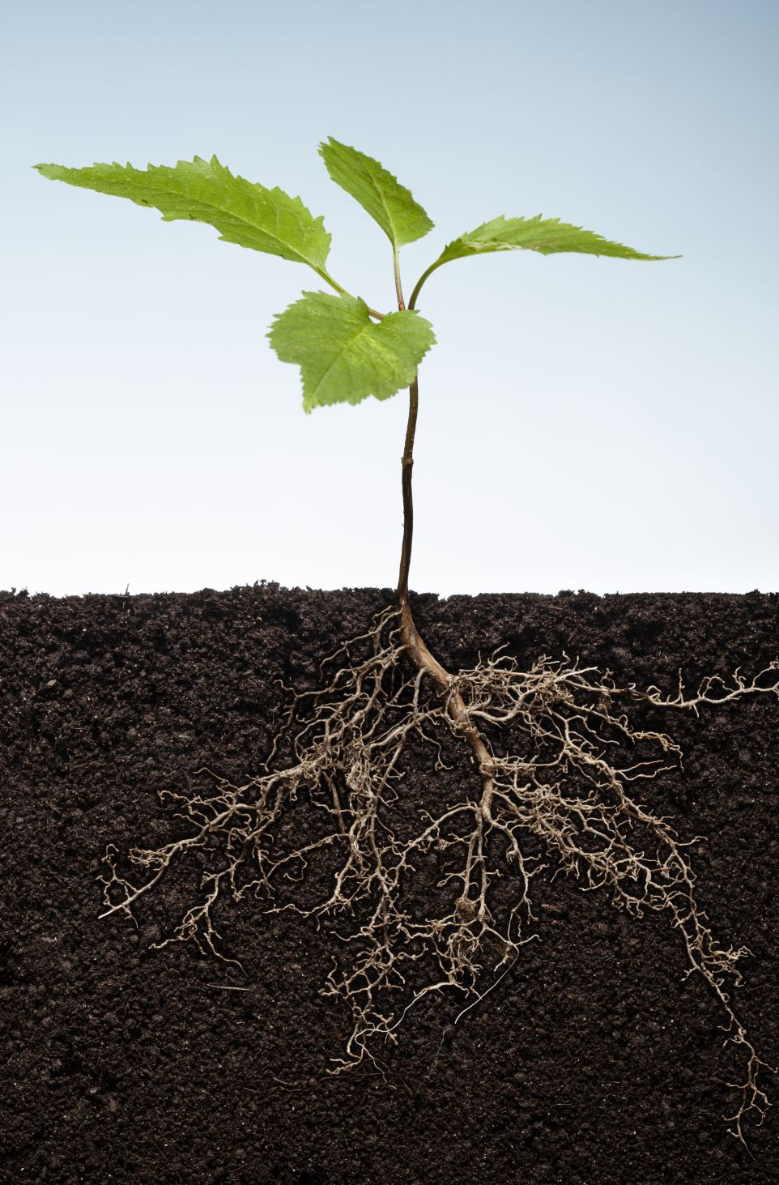
Pattern Recognition ECSE 4410/6410 CAPA Spring 2022 Supportive Material Part II
Lecture #8
Course Instructor - Thirimachos Bourlai
Fall 2022
Please Check the 2022 Syllabus

Slide 2
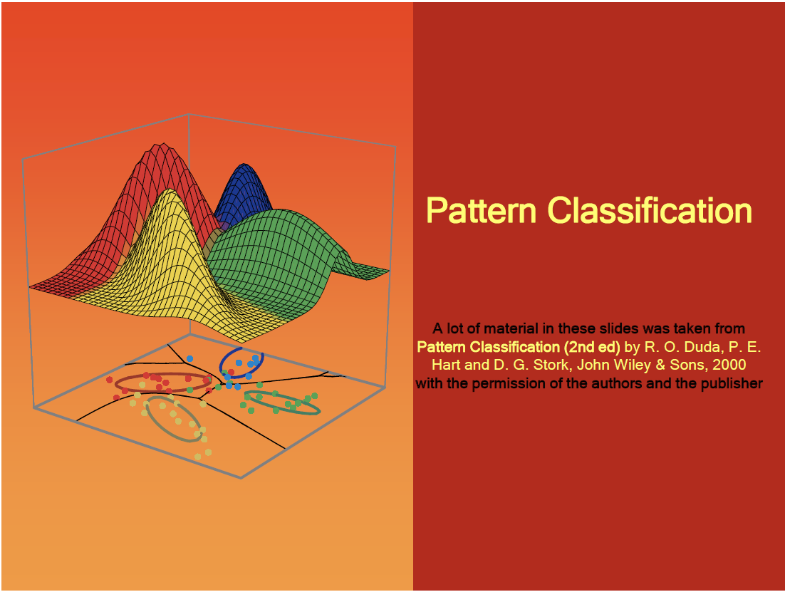
Some slides are taken from CS 559: Machine Learning Fundamentals and Applications - Philippos Mordohai, Webpage: www.cs.stevens.edu/~mordohai

Slide 3
Hypothesis Testing vs. PR (1/2)
Statistical Hypothesis Testing (HT): the sensed data are used to decide whether or not to reject a null hypothesis in favor of some alternative hypothesis
If the probability of obtaining the data (given some null hypothesis) falls below a “significance” threshold, we reject the null hypothesis in favor of the alternative.
EXAMPLES:
HT: often used to determine whether a drug is effective, (null hypothesis is that it has no effect)
HT: used to determine whether the fish on the conveyor belt belongs to a single class (the null hypothesis) or from two classes (the alternative).

Slide 4
Hypothesis Testing vs. PR cont.
Given some data,
> Pattern classification seeks to find
> the most probable hypothesis
> from a set of hypotheses
— “this fish is probably a salmon.”

Slide 5
PR vs. Image Processing
Pattern classification differs from image processing
In image processing, the input is an image
and the output is an image.

Slide 6
PR vs. Feature Extraction (FE)
FE input = a pattern; FE output = feature values
# Features (chosen) < Total # Features (necessary to describe the complete target of interest) → loss in information
Associative Memory:
> System Input = Pattern
> System Output = Another Pattern
(representative of a general group of patterns)
→ information is reduced but rarely to the extent that P classif. does
Because of the crucial role of a decision in PR information, it is fundamentally an information reduction process.
Classification Step = even more radical loss of information (reducing the original [n×Kbits] (e.g. representing an image) down to just a few bits representing the chosen category, i.e. a single bit in our fish example

Slide 7
Class Updates
Homeworks 1 and 2: Expected by this Sunday, Jan 21st 5pm.
Project: to be picked by Jan 19th > send me an email with your team and topic
Jan 31st Deadline for Report #1 (topic into and literature review)
End of Feb 28th – deadline for project report

Slide 8
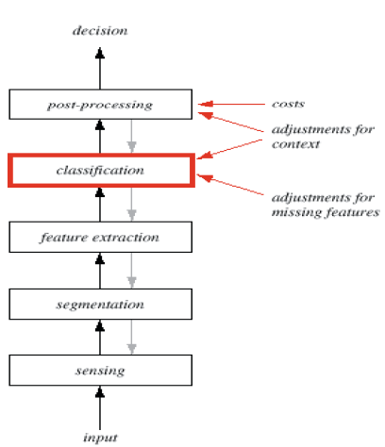
PR Flow Chart

Slide 9
Pattern Recognition Systems
• Sensing
– Use of a transducer (camera or microphone)
– PR system depends of the bandwidth and the
resolution sensitivity distortion of the transducer
• Segmentation and grouping
– Patterns should be well separated and should not overlap

Slide 10
Pattern Recognition Systems
Feature extraction
– Discriminative features
– Invariant features with respect to translation, rotation and scale
Classification
– Use a feature vector provided by a feature extractor to assign the object to a category
Post Processing
– Exploit context (other than the target pattern itself) to improve performance

Slide 11
The Design Cycle
• Data collection
• Feature Choice
• Model Choice
• Training
• Evaluation
• Computational Complexity

Slide 12
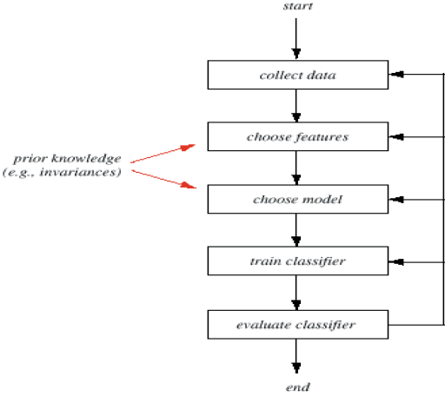
The Design Cycle
PR Flow Chart

Slide 13
Feature Extraction
An ideal feature extractor => a representation that makes the job of the classifier trivial [or an omnipotent classifier would not need the help of a sophisticated feature extractor]
The task of FE is much more problem and domain dependent than is classification
e.g. A good FE for sorting fish would surely be of little use for identifying fingerprints etc.
How do we know which features are most promising?
Are there ways to automatically learn which features are best for the classifier?
How many shall we use?

Slide 14
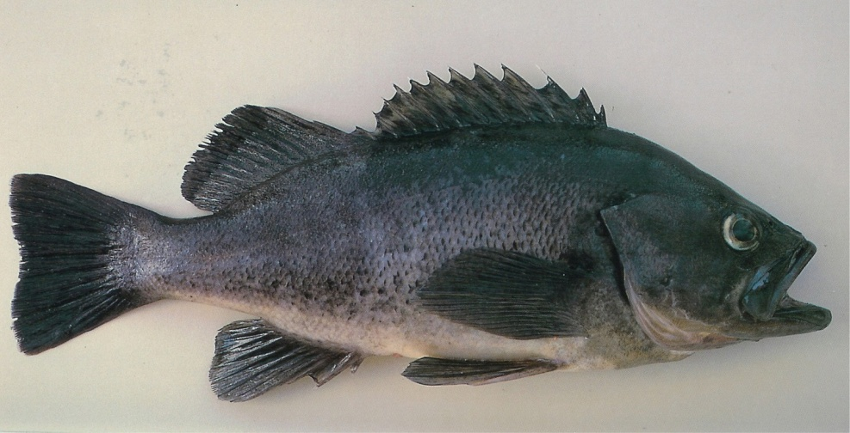
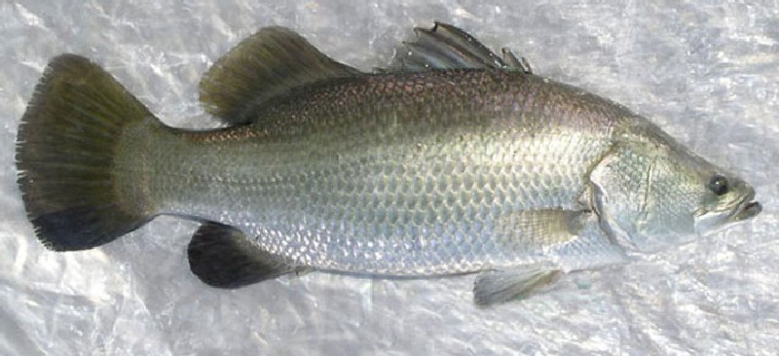
Original
Contrast
high and low

Slide 15
Original
Bѵ
B^
Bѵ
B^

Slide 16
Noise
General Definition: any property of the sensed pattern due not to the true underlying model but instead to randomness in the world or the sensors
> All non-trivial decision and PR problems involve noise
In some cases, it is due to the transduction in the signal and we may consign to our pre-processor the role of cleaning up the signal
An important problem is knowing whether the variation in some signals is 1-source noise or instead there is a complex underlying model
How then can we use this information to improve our classifier?
Notes:
The lighting of the fish may vary, there could be shadows cast by neighboring equipment, the conveyor belt might shake — all reducing the reliability of the feature values actually measured.

Slide 17
Noise - Example
The lighting of the fish may vary
There could be shadows cast by neighboring equipment
The conveyor belt might shake
All reducing the reliability of the feature values actually measured.
Notes:
The lighting of the fish may vary, there could be shadows cast by neighboring equipment, the conveyor belt might shake — all reducing the reliability of the feature values actually measured.

Slide 18
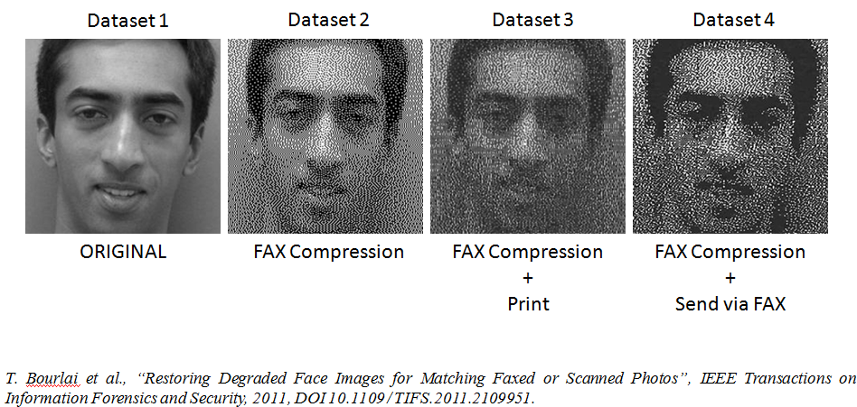
Noise - Example
Notes:
The lighting of the fish may vary, there could be shadows cast by neighboring equipment, the conveyor belt might shake — all reducing the reliability of the feature values actually measured.

Slide 19
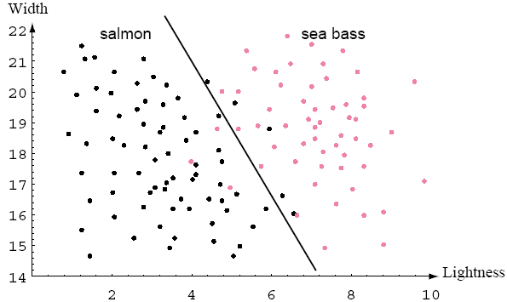
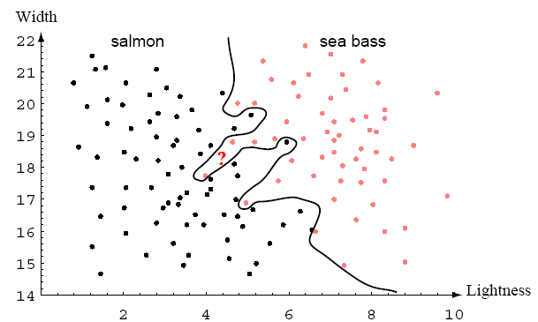
Over-fitting
More Complex Classifier is Needed
vs.
One of the most important areas of research in statistical pattern classification is determining how to adjust the complexity of the model
not so simple that it cannot explain the differences between the classes
yet not so complex as to give poor classification on novel patterns
Over-fitting Definition: An overly complex model may allow perfect classification of the training samples, it is unlikely to give good classification of novel patterns

Slide 20
Model Selection
How do we know when a hypothesized model differs significantly from the true model underlying our patterns, and thus a new model is needed?
How are we to know to reject a class of models and try another one?
Random and tedious “trial and error” in model selection: should we do this never really knowing whether we can expect improved performance?
Can we automate the selection process?

Slide 21
Prior Knowledge
Incorporating prior knowledge can be a very difficult task
In some applications the knowledge ultimately derives from information about the production of the patterns
In other applications the knowledge may be about:
The form of the underlying categories, or
Specific attributes of the patterns, such as the fact that a face has two eyes, one nose, and so on

Slide 22
Missing Features
During classification, the value of one of the features cannot be determined, e.g. fish width due to occlusion by another fish
Our two-feature recognizer never had a single-variable threshold value x∗ determined in anticipation of the possible absence of a feature → what do we do?
Naive Method: assume that the value of the missing feature is zero or the average of the values for the training patterns
Likewise we occasionally have missing features during the creation or learning in our recognizer. How should we train a classifier or use one when some features are missing?

Slide 23
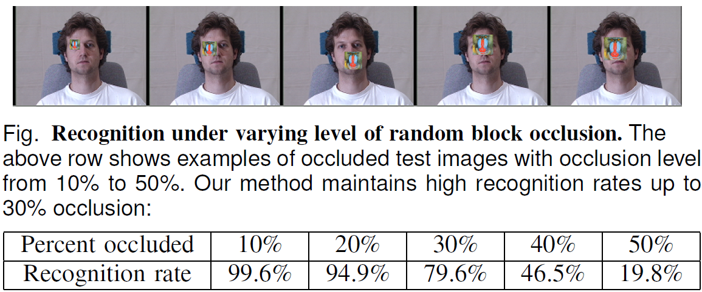
Missing Features - Example
http://perception.csl.illinois.edu/recognition/Files/faces_system.pdf
What are sparse representations/approximations?
SR are representations that account for most or all information of a signal with a linear combination of a small number of elementary signals called atoms. Often, the atoms are chosen from a so called over-complete dictionary.
Formally, an over-complete dictionary is a collection of atoms such that the number of atoms exceeds the dimension of the signal space, so that any signal can be represented by more than one combination of different atoms.

Slide 24
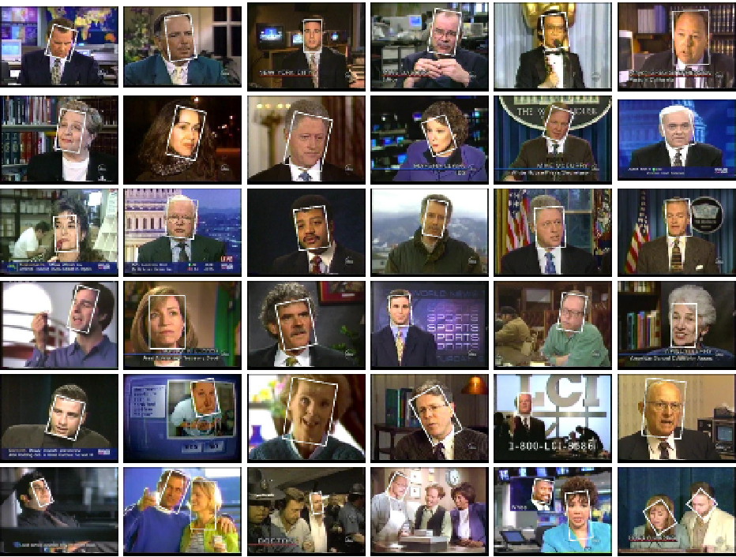
Segmentation
But how can we segment the images before they have been categorized or categorize them before they have been segmented?
We need a way to know when we have switched from one model to another!

Slide 25
Context
Definition: input-dependent information other than from the target pattern itself— to improve our recognizer.
e.g. it might be known for our fish packing plant that if we are getting a sequence of salmon, that it is highly likely that the next fish will be a salmon
Thus, if after a long series of salmon our recognizer detects an ambiguous pattern, it may be best to categorize it too as a salmon
A simple correlation among patterns — the most elementary form of context (might be used to improve recognition)
But how, precisely, should we incorporate such information?

Slide 26
Invariances
The problem: trying to achieve an optimal representation for a particular pattern classification task
e.g. Fish example: the absolute position on the conveyor belt is irrelevant to the category and thus our representation should also be insensitive to absolute position of the fish
→ We seek a representation that is invariant to the transformation of translation

Slide 27
Invariances cont.
The “model parameters” describing the orientation of our fish on the conveyor belt are very complicated (due to sloshing of water, the bumping of neighboring fish, the shape of the fish net, etc.)
These parameters are irrelevant to the model parameters that interest us, i.e., the ones associated with the differences between the fish categories.

Slide 28
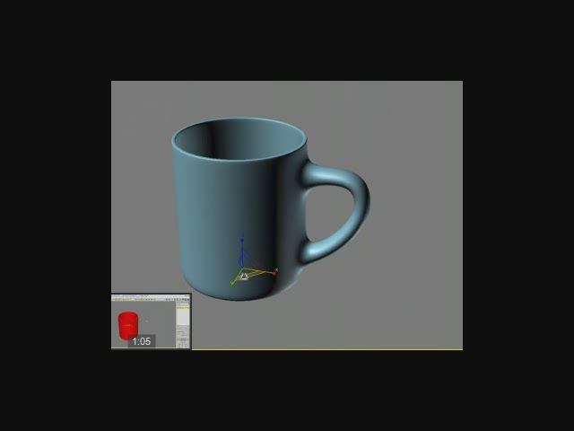
Orientation
The image of “simple” objects (e.g. coffee cup) undergoes radical variation as the cup is rotated to an arbitrary angle — the handle may become hidden etc.
How might we insure that our pattern recognizer is invariant to such complex changes?

Slide 29
Size
The overall size of an image may be irrelevant for categorization
Such differences might be due to variation in the range to the object
Alternatively, we may be genuinely unconcerned with differences between sizes — a young, small salmon is still a salmon.
But, how about FR and the effect of spatial resolution?

Slide 30
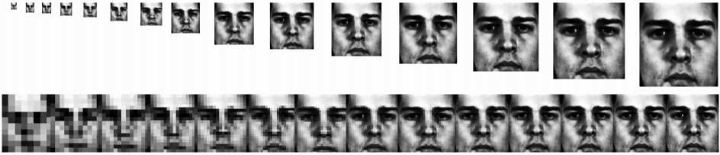
Size - Example
Does the size of a face image affect recognition performance?
[1] T. Bourlai, K. Messer and J. Kittler. "Performance Based Optimization in Face Verification using Smart Cards". Audio- and Video-based Biometric Person Authentication, New York, U.S.A., 2005.

Slide 31
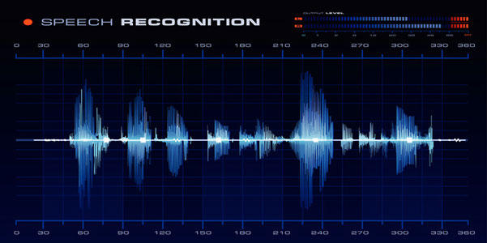
Rate at which patterns evolve…
Speech Recognition: Rate variation is a deep problem
Different individuals talk at different rates
BUT even a single talker may vary in rate, causing the speech signal to change in complex ways
Can we design a recognizer (classifier) that changes its representations (features) for some categories (classes) differently from that for others under such rate variation?
Notes:
Inter- intra-class variations!

Slide 32
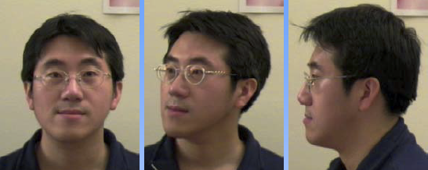
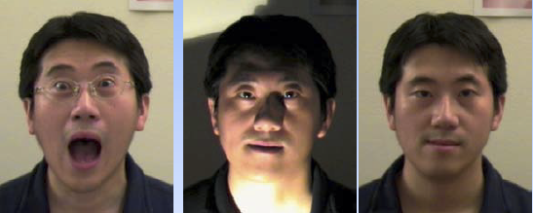
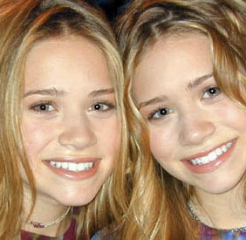
Why FR is Difficult?
Intra-class variability (1)
Inter-class similarity (2)
Segmentation
Noisy input
Population coverage
System performance
(error rate, speed, cost)
Scalability
(1)
[3]
(2)
[3] Stan Li et al., " Handbook of Face Recognition ", Springer, 2008.
www.marykateandashley.com

Slide 33
DEFORMATIONS
Variations in shape (stretched face images…)
Variations in illumination (indoor vs. outdoor data)
Effect of shadows …

Slide 34
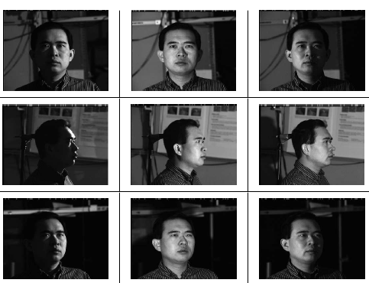
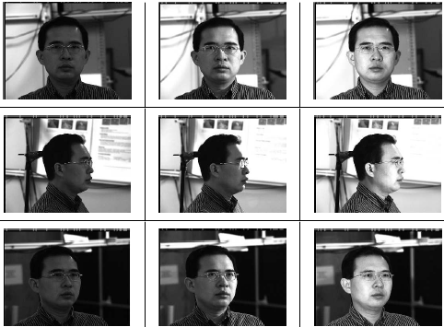

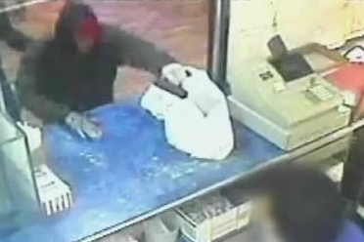
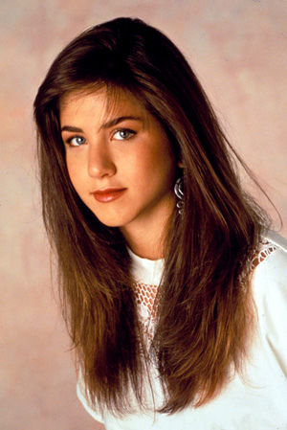
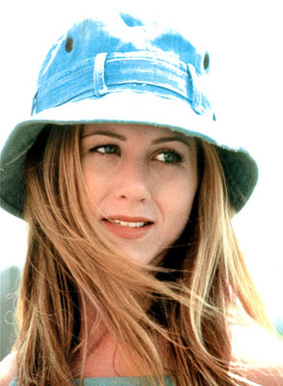
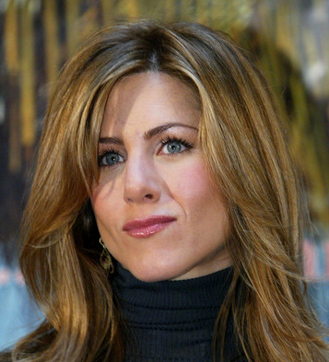
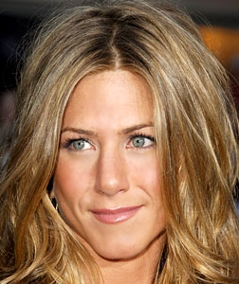
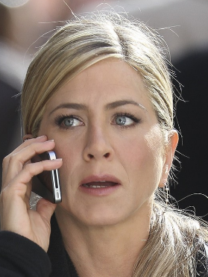
Illumination and Pose Variations
Controlled Conditions
Uncontrolled Conditions
Aging
1993
1999
2004
2008
2011

Slide 35
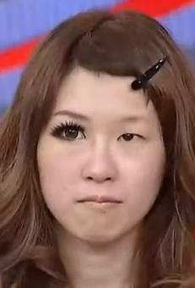
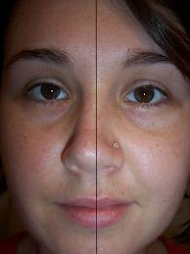
Symmetry
When designing recognizers: how do we determine whether an invariance (in terms of symmetry or other) is present?
How do we efficiently incorporate such knowledge into our recognizer?

Slide 36
Evidence Pooling
Fish example: by using multiple features, we can achieve improved recognition → we may do better if we had several component classifiers (categorizers)
If these classifiers agree on a particular pattern → good
If these classifiers disagree → How should a “super” classifier pool the right evidence to achieve the best decision?

Slide 37
Evidence Pooling
> Imagine calling in ten experts for determining if a particular fish is diseased or not. While nine agree that the fish is healthy, one expert does not. Who is right?
- What if the 1 is right that does not? > minority opinion…
Minority Opinion…

Slide 38
Costs and Risks
A classifier is generally used to recommend actions (put this fish in this bucket, put that fish in that bucket)
Each action has an associated cost or risk.
The simplest such risk is the classification error: “What percentage of new patterns are called the wrong category”
Classifiers are often designed to recommend actions that minimize some total expected cost or risk.
Thus, in some sense, the notion of category itself derives from the cost or task.

Slide 39
Computational Complexity
What is the tradeoff between computational ease/complexity and performance (case study)?
By manually labeling all possible 20 × 20 binary pixel images with a category label for OCR, and use table lookup to classify incoming patterns → 100% recognition accuracy
BUT: the labeling time and storage requirements would be quite prohibitive since it would require a labeling each of 20×20 ≈ …. patterns.

Slide 40
Learning and Adaptation
Training patterns can be used to learn or estimate the unknown parameters of the model
> General Definition: Learning refers to some form of algorithm for reducing the error on a set of training data
Gradient Descent algorithms that alter a classifier’s parameters in order to reduce an error measure now permeate the field of statistical PR

Slide 41
Supervised Learning
A category label or cost is provided for each pattern in a training set, and we seek to reduce the sum of the costs for these patterns.
How can we be sure that a particular learning algo-rithm is powerful enough to learn the solution to a given problem and that it will be stable to parameter variations?

Slide 42
Unsupervised Learning
In unsupervised learning or clustering there is no explicit teacher, and the system forms clusters or “natural groupings” of the input patterns.
Given a particular set of patterns or cost function, different clustering algorithms lead to different clusters
Often the user will set the hypothesized number of different clusters ahead of time
But (i) how should this be done, and (ii) how do we avoid inappropriate representations?

Slide 43
Questions?
Thank you!

